Slide 1






Enhanced environmental protection inspection for efficient control of air quality monitoring and of all entities under obligation within system of greenhouse gas emission allowance trading, in order to achieve better quality of air in Republic of Croatia
This project is funded by the European Union

Slide 2



THEME 5: Network Design
Energy Research and Environmental Protection Institute
Mato Papić dipl. ing. stroj.
Bojan Abramović dipl. ing. stroj.

Slide 3

5.1 THE MAIN OBJECTIVES
The first step in designing the air quality monitoring network is to define the goals that this network must meet. When designing a network, it is important to keep in mind that investments do not stop with the purchase of very expensive equipment. It is a long-term expenditure for measuring and technical network management.
Energy Research and Environmental Protection Institute

Slide 4
5.1 THE MAIN OBJECTIVES
At the beginning, before any investment is necessary to make clear to investors that it is a narrowly specialized field and that from the moment of design through the selection and procurement of equipment and of defining the measurement points to the performance measurement and data processing the job must entrust the competent and well trained a group of people ready to work hard.
In his work the author has witnessed cases of large investments that are due to the wrong choice of experts ended without achieving a basic goal – high quality data on air quality.
Energy Research and Environmental Protection Institute

Slide 5
5.1 THE MAIN OBJECTIVES
Defining the goals of the network is the first step in the design of each network.
Setting too ambitious or too simple goals will lead to a network that will not be easy to manage and the measuring data will not be sufficiently exploited or those who fund the network will think they do not get enough of their investment. For this reason, investors and experts in air quality must be involved in this business, as well as the final beneficiaries of monitoring data. It is wrong to focus only on one goal, eg meeting regulatory requirements, because the information obtained by monitoring can certainly be used for other purposes as well.
Energy Research and Environmental Protection Institute

Slide 6
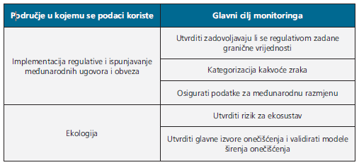
5.1 THE MAIN OBJECTIVES
Air quality data must be available to anyone who requests them. Each properly designed network will fulfill the goals for which funds are invested in its setup and management. Although each network has its own general and specific goals and they can, however, be grouped into several basic ones as shown in the Table.
Energy Research and Environmental Protection Institute

Slide 7
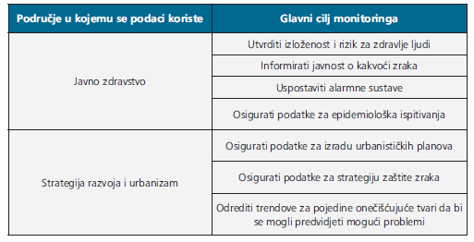
5.1 THE MAIN OBJECTIVES
Extension of table
Of course, some of these goals can and should be used in more than one area which will only improve the utilization of the data and information obtained by monitoring.
Energy Research and Environmental Protection Institute

Slide 8
5.2 SELECTION OF MEASUREMENT POINTS
Each measurement station analyses the air that is located directly around it. There is a known case when measuring stations have not recorded any unusual air pollution despite of large fire of the industrial plant in their vicinity.
On the other hand, it happens to be recording a great instantaneous pollution just for burning nearby weeds. For this reason, during the design of the network, special attention has to be paid to the choice of measuring points.
Energy Research and Environmental Protection Institute

Slide 9
5.2 SELECTION OF MEASUREMENT POINTS
Measurement sites must be representative for the area which should be covered and for pollutants that we want to monitor. Some of the basic factors that need to be taken into consideration when defining the location of measurement locations are as follows:
• the major sources of emissions in the area of the future
network
• the results of periodic measurements and/or model
• meteorological factors
• topographical factors on the makrolocation and mikrolocation
level
• demographic and epidemiological factors.
Energy Research and Environmental Protection Institute

Slide 10
5.2 SELECTION OF MEASUREMENT POINTS
In order to avoid obtaining accurate but useless data, attention must be paid to both the macrolocation and microlocation positioning of the stations and the sampling system, and they need to be matched to the monitoring goals of the particular network.
According to the monitoring objectives, the location of the stations and the pollutants that are being monitored are also different. Based on that, the name and type of station are defined. The most important station types are shown in the Table.
Energy Research and Environmental Protection Institute

Slide 11
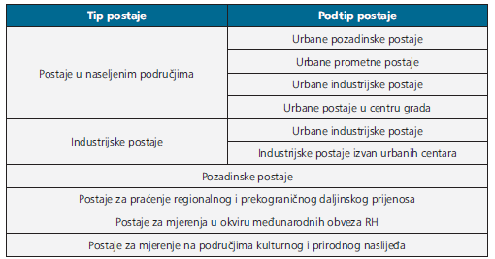
5.2 SELECT MEASUREMENT POINTS
Types of stations with respect to the objectives and the location
Since this is an extremely complex area of great importance for achieving monitoring goals, this area is legally regulated in the world but also in our country.
Energy Research and Environmental Protection Institute

Slide 12
5.2 SELECTION OF MEASUREMENT POINTS
Ordinance on air quality monitoring, (NN19/2017)
Appendix 1
The locations of fixed measurement points for measuring concentration of sulphur dioxide, nitrogen oxide, nitrogen dioxide and airborne particulate matter (PM10 and PM2, 5), lead, benzene and carbon monoxide in the air
SECTION B
Positioning of sampling points at the macro level
Protection of human health
Protection of vegetation and natural ecosystems
SECTION C
Deployment of the measurement points on the micro level
Energy Research and Environmental Protection Institute

Slide 13
5.2 SELECTION OF MEASUREMENT POINTS
Ordinance on monitoring air quality (NN19/2017)
Appendix 4
Criteria for classifying and setting points of sampling to estimate concentrations of ground-level ozone
SECTION A
Macro location
SECTION B
Micro location
Energy Research and Environmental Protection Institute

Slide 14
5.3 METHODS OF MEASUREMENTS
Measuring and non-measuring equipment
The equipment required to create air quality monitoring network must be such as to enable getting targeted quality of data. In short, it must enable continuous measurements by prescribed methods with as little interruption as possible and with as much accuracy as possible, i.e. measurements within the prescribed uncertainty measurement.
Energy Research and Environmental Protection Institute

Slide 15
5.3 METHODS OF MEASUREMENTS
In order to achieve this, it is also necessary to provide, besides measuring equipment (measuring instruments), non-measuring equipment (isothermal shelters, sampling systems, air-conditioning systems, fire-fighting and fire alarm systems and alarm systems). In General, equipment in air quality monitoring networks can be divided into two basic groups: measuring and non-measuring devices.
Energy Research and Environmental Protection Institute

Slide 16
5.3 METHODS OF MEASUREMENTS
Measuring devices
Selection of measuring devices will be defined by measurement method which is, for the most important pollutants, defined by regulation. Although regulations in the Republic of Croatia and the EU defines standardized methods (most commonly called CEN standards in professional surroundings), it allows the use of other methods for individual pollutants as long as it can be proven that they are equivalent to standardized methods.
Energy Research and Environmental Protection Institute

Slide 17
5.3 METHODS OF MEASUREMENTS
In practice, it is much simpler for regulatory-defined measurements to immediately decide on instruments that use metering methods defined by regulation because proof of equivalence of alternative methods may have a price higher than the price of such instruments.
The choice of these instruments, in the case of classical pollutants, is facilitated by the CEN standards, which as their constituent part define the so-called TYPE APPROVAL.
Energy Research and Environmental Protection Institute

Slide 18
5.3 METHODS OF MEASUREMENTS
Type Approval Tests are in fact a series of testing of individual instrument types in order to demonstrate the ability of the instrument to meet the standard of precisely defined performance characteristics that a particular type of instrument must have. If a type of instrument satisfies these requirements, the EU Member State issues the Certificate with the most basic data on the type of instrument and the test results. This certificate is called the type approval.
Type approval is valid for all instruments of the same type of some manufacturer for which it has been proven (by an independent laboratory) to meet the standard performance criteria.
Energy Research and Environmental Protection Institute

Slide 19
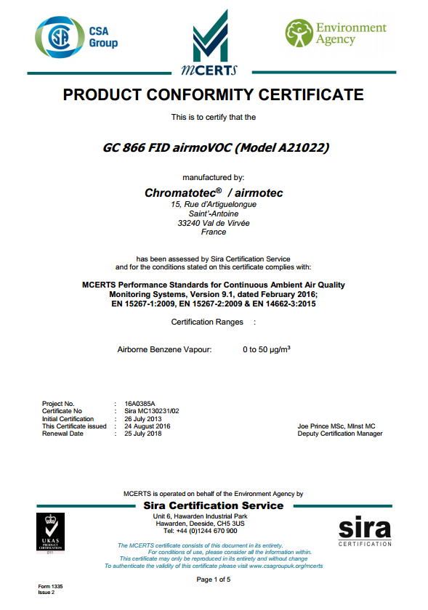
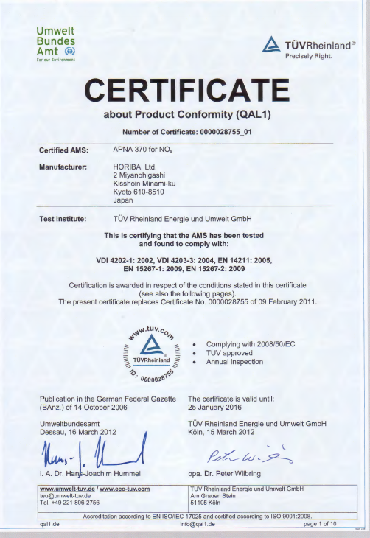
5.3 METHODS OF MEASUREMENTS
Type approval Mcerts (UK)
http://www.csagroupuk.org/services/mcerts/mcerts-product-certification/mcerts-certified-products/
Type approval UBA (NJE)
http://www.qal1.de/en/index.htm
Energy Research and Environmental Protection Institute

Slide 20
5.3 METHODS OF MEASUREMENTS
Manufacturers of measuring instruments finance the making of type approvals for their instruments.
By purchasing measuring instruments that have type approval, it is possible to measure according to regulatory requirements and greatly simplify the selection of measuring equipment.
Thus, when purchasing instruments, it is often enough to require that the instrument has a valid type-approval in accordance with the CEN standard defined for the pollutant to be measured.
Energy Research and Environmental Protection Institute

Slide 21
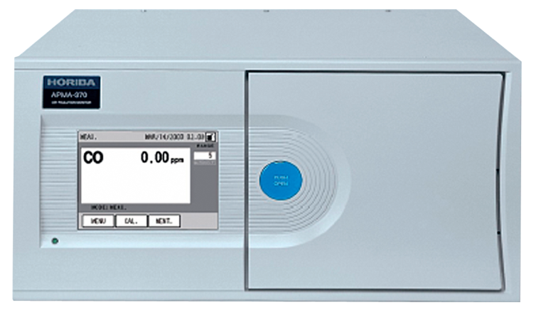
5.3 METHODS OF MEASUREMENTS
The picture shows an instrument for carbon monoxide (CO) measurement having a valid type-approval in the Republic of Croatia and EU according the CEN-standard HRN EN 14626. The producer is Horiba company from Japan.
Horiba APMA-370 monitor carbon monoxide in the air.
Energy Research and Environmental Protection Institute

Slide 22
5.3 METHODS OF MEASUREMENTS
Of course, during purchasing of equipment, it is necessary to ask for the type approval certificate issued by a competent authority in one of the Member States of the EU.
Measuring equipment, in a broader sense, besides instruments includes the system for the automatic checking of the instrument's response to the default calibration gases.
Measurements of meteorological factors are often performed with air quality measurements at the same station. Most commonly, measurements of temperature, humidity and air pressure, as well as speed and wind measurements.
Energy Research and Environmental Protection Institute

Slide 23
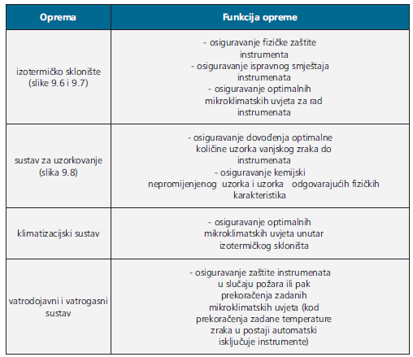
5.3 METHODS OF MEASUREMENTS
Non-measuring equipment
Non-measuring equipment in networks represents all the equipment needed for the operation of the network and ensuring the optimal conditions in which instruments can be properly and long-term work. Non-measuring equipment and its functions are shown in the table.
Energy Research and Environmental Protection Institute

Slide 24
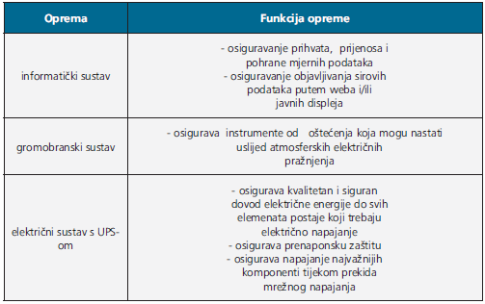
5.3 METHODS OF MEASUREMENTS
Extension table
Energy Research and Environmental Protection Institute

Slide 25
5.3 METHODS OF MEASUREMENTS
Selection of the non-measuring equipment is almost as important as the selection of measuring equipment.
Only properly selected non-measuring equipment will enable measurements that will result in the data of satisfactory quality and will ensure investment in measurement equipment.
For this reason, it is important during purchasing such equipment does not use improvisations and unjustified economy. It should be noted that some of the components of the non-measuring equipment are subject to regulations in the field of fire protection and safety at work and that their design, maintenance and certification require engage of authorized institutions.
Energy Research and Environmental Protection Institute

Slide 26
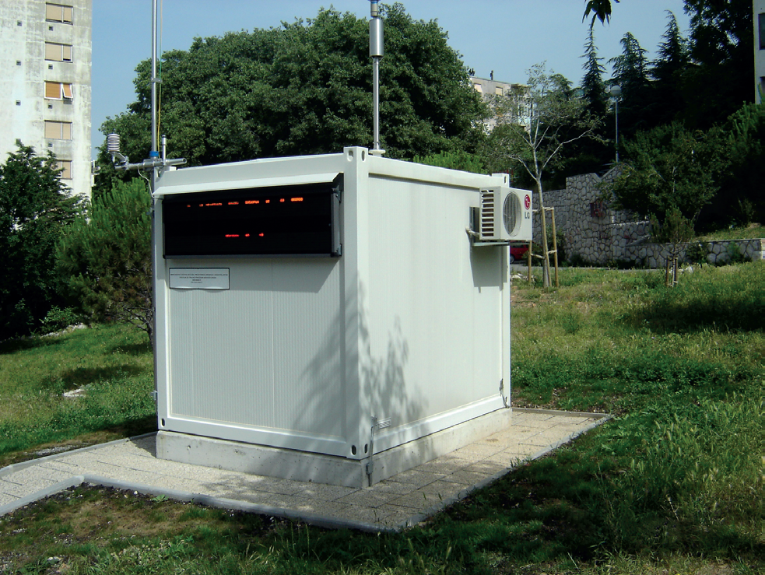
5.3 METHODS OF MEASUREMENTS
Izothermic shelter from the outside (also the elements of sampling and air conditioning systems are visible).
Energy Research and Environmental Protection Institute

Slide 27
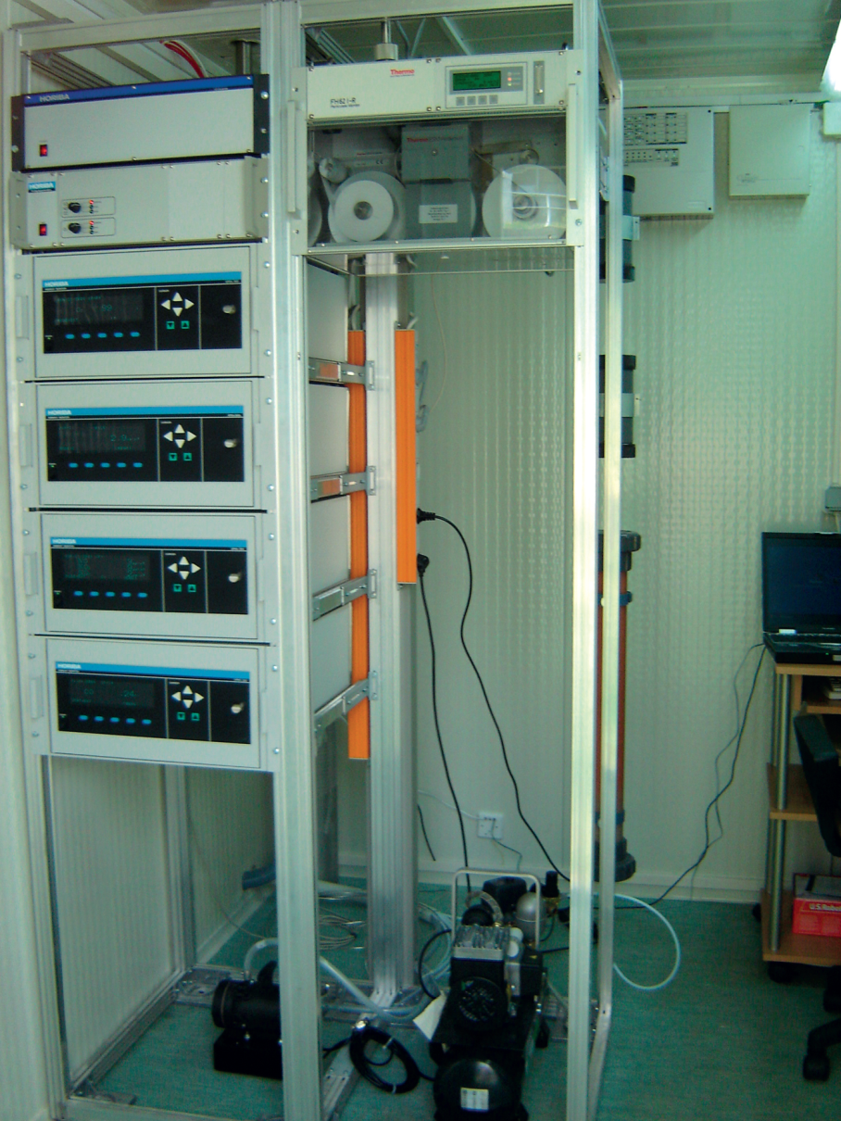
5.3 METHODS OF MEASUREMENTS
Isothermal shelter from the inside (measuring instruments placed in appropriate standardized frames).
Energy Research and Environmental Protection Institute

Slide 28
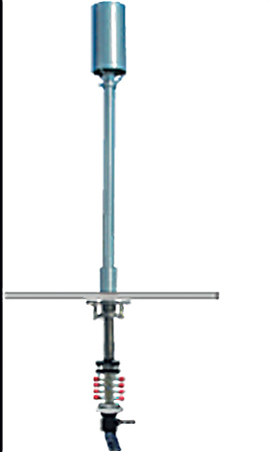
5.3 METHODS OF MEASUREMENTS
An air sampling system for measurement of gaseous pollutants.
Energy Research and Environmental Protection Institute

Slide 29
5.3 METHODS OF MEASUREMENTS
Network organizational structure
Managing of air quality monitoring networks is an extremely demanding task. Because of the multidisciplinarity, complexity and complexity of the work that must be done to make a network meet its goals, this job is rarely carried out by an institution independently. Most often, one umbrella organization coordinates the work of several institutions that carry out every part of their work. Although the organizational structure will depend on different factors, primarily on the goals and complexity of the network itself (covering area, number of stations, polluting substances monitored, equipment, etc.), the basic criterion for assessing a good network organization is its functionality.
Energy Research and Environmental Protection Institute

Slide 30
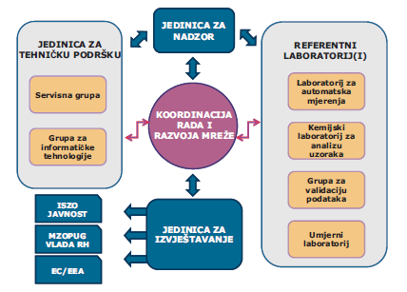
5.3 METHODS OF MEASUREMENTS
The typical organizational structure of the network
Energy Research and Environmental Protection Institute

Slide 31
5.3 METHODS OF MEASUREMENTS
To be able to perform its function properly, each of the organizational subunits should be well-teamed and equipped. Subgroups so assembled can often perform their specialized work for several different networks. In continuation
the most important organizational subunits will be described.
Coordination of network operation and development
This subunit, of course, is the most important for every network. Its basic function is to maintain functionality and meet network goals. In this subunit most often there are representatives of network investors, i.e. its owners.
Energy Research and Environmental Protection Institute

Slide 32
5.3 METHODS OF MEASUREMENTS
It is their responsibility to ensure the data for which is invested into the network. To perform this task, they engage other subunits, monitor them and provide them with the necessary resources.
For large State-owned network, that work is usually performed by Ministry or agency responsible for the environmentally protection, and in local networks the offices of local governments responsible for the same area.
The function of supervision over the work of the laboratory is most often done through inspection of environmental protection inspector sand/or quality of laboratory work is checked by the system of accreditation through the accreditation agency.
Energy Research and Environmental Protection Institute

Slide 33
5.3 METHODS OF MEASUREMENTS
Air quality laboratories
Air quality laboratories represent a professional core of each network. They ensure the quality of the data obtained by automatic measurements or perform analyses of samples obtained by sampling at the stations. Fulfillment of these tasks requires the establishment of a quality system. With quality system, the provable conditions for obtaining the measuring data of the required uncertainty measurement are set and ensure that the measurements comply with the prescribed standardized methods.
Energy Research and Environmental Protection Institute

Slide 34
5.3 METHODS OF MEASUREMENTS
Laboratory for continuous (automated) measurements
performs measurements at stations with automatic analysers for individual pollutants.
The job requires specialized personnel with the classic skills of good laboratory practices and knowledge related to modern telemetry techniques.
Since the measurements are automatic and continuous, a quality laboratory must know at all times all the facts related to the operation of measuring and non-measuring equipment that may affect the measurement quality.
Energy Research and Environmental Protection Institute

Slide 35
5.3 METHODS OF MEASUREMENTS
This part of work in networks is often neglected. Also, it is often case of a technical point of view only: "the instrument works or does not work" or "there is no need for measurement, instrument measures".
The results of such measurements can often be extremely uncomfortable due to regulatory consequences for plant owners. Therefore, the continuous measurement laboratory must be able to guarantee quality and documentation for each measurement data obtained by such measurements.
Energy Research and Environmental Protection Institute

Slide 36
5.3 METHODS OF MEASUREMENTS
Measured data thus obtained, before being validated, must undergo a procedure called validation and ratification.
Validation and ratification of data is the most demanding and the most responsible part of the work of the laboratory for automatic measurements.
Energy Research and Environmental Protection Institute

Slide 37
5.3 METHODS OF MEASUREMENTS
Calibration laboratory for air quality
in this context it implies laboratory for calibration of automatic instruments. The main task of this laboratory is to ensure measurement traceability of all automated measurements in a network.
This is accomplished by calibration of instruments in the laboratory and at the stations themselves with the help of certified standards (most often gas bottles) and by organizing intercomparative measurements (proficiency testing).
Energy Research and Environmental Protection Institute

Slide 38
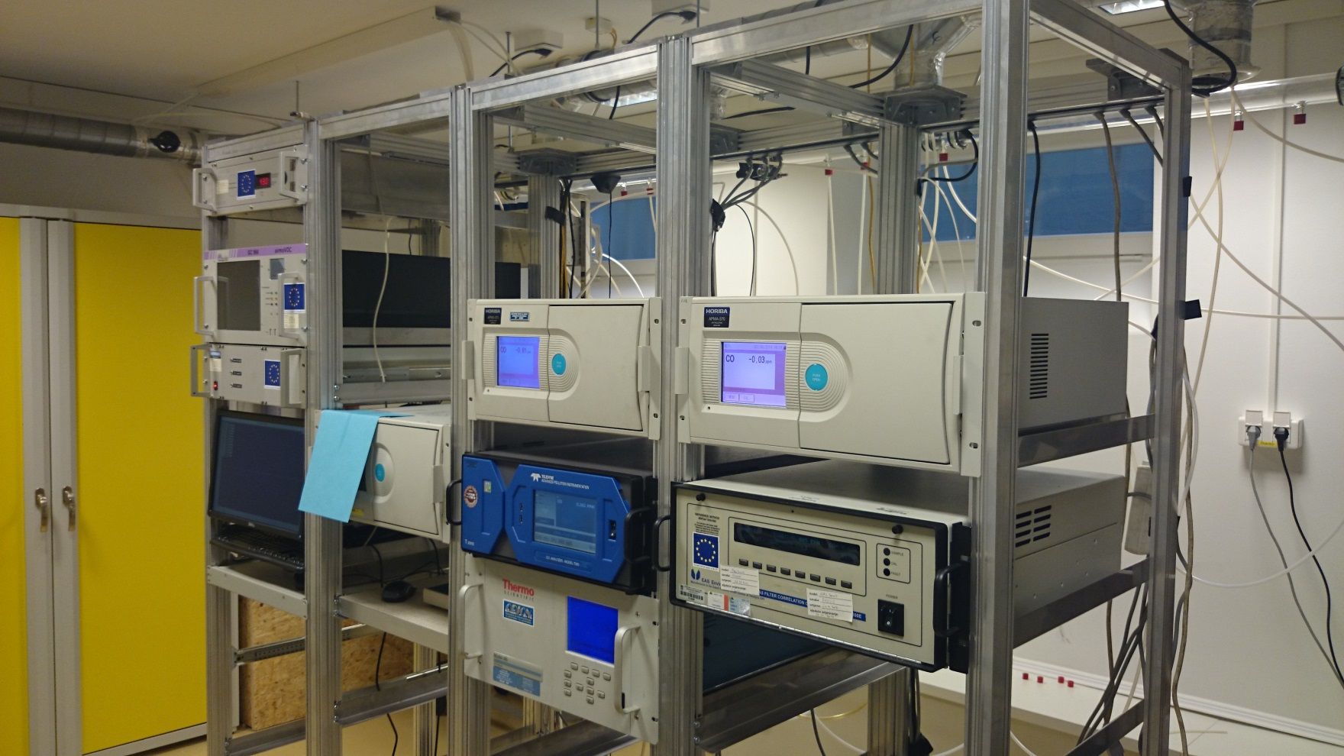
5.3 METHODS OF MEASUREMENTS
Calibration laboratory for air quality
Energy Research and Environmental Protection Institute

Slide 39
5.3 METHODS OF MEASUREMENTS
Laboratory for Sample Analysis
is the classic chemical laboratory which is in his work uses the most modern techniques. It is a laboratory that has a demanding task to designate a lot of different analytes from a relatively small sample at very low concentrations. The most common analytical methods in these labs are ionic chromatography (IC), atomic absorption spectrometry (AAS), inductively coupled plasma mass spectromerography (ICP MS) and gas or liquid chromatographic mass spectrometry (GC / HPLC MS). Such a laboratory must be teamed with exceptionally high quality, highly specialized laboratory personnel.
Energy Research and Environmental Protection Institute

Slide 40
5.4 MAINTENANCE AND NETWORK COSTS
Unit for technical support
The operation of any air quality monitoring network is unthinkable without the quality of technical support. The task of this unit is to ensure the technical accuracy of measuring and non-measuring equipment across the network in 90% of the network operation time. This implies maintenance of measuring instruments, conditions in isothermal shelters, maintenance of sampling systems and samplers, maintenance of fire alarm and alarm systems, and provision of electronic communications with the stations and public communications systems.
Energy Research and Environmental Protection Institute

Slide 41
5.4 MAINTENANCE AND NETWORK COSTS
At the same time, this unit must cooperate with the laboratories in a quality and continuous manner.
This demanding task can perform only extremely well-trained and highly specialized group of people with the technical education of information technology (it), electro-mechanical and mechanical proffesion ready for work with no fixed working hours, and on frequent trips.
Energy Research and Environmental Protection Institute

Slide 42
5.4 MAINTENANCE AND NETWORK COSTS
Network costs
When designing a network it is necessary to have in mind that the establishment of a network is extremely expensive and that the financing of the network nearly does not end with the purchase of equipment.
The basic costs, some of which are one-off and some are continuous, are as follows:
• the cost of designing network - one-off
• construction of infrastructure (electricity, phone, grounding, base station)-one-off
• purchase of measuring and non-measuring equipment – one-off
• the costs of setting up the stations - one-off
• attesting (electrical installations, fire protection system and fire alarm) - continuously
Energy Research and Environmental Protection Institute

Slide 43
5.4 MAINTENANCE AND NETWORK COSTS
• the costs of the professional regular and intervention maintenance (labor, consumables, spare parts) – continuously
• laboratory Costs (Collection of Samples, Sample Analysis, Quality Assurance, Data Validation) – continuously
• material costs of quality assurance (reference material and devices, profficiency testing) – continuously
• data management costs (collecting, processing, publishing and storing data) – continuously
• operating costs (rental places, electricity, telephone) – continuously.
When trying to estimate ongoing costs on an annual basis, there is usually 10% of the initial investment amount.
Energy Research and Environmental Protection Institute

Slide 44
5.4 MAINTENANCE AND NETWORK COSTS
The investement costs will depend on the design of the network (the number of stations, the location of the stations, measurement methods, as well as the choice of the manufacturer of the instruments).
When choosing instruments lowest price is often not the best choice.
There is also a need to consider service support in the country because a cheap instrument with an authorized service technician 1000 km away and several state borders often results in unsatisfactory data coverage and / or poor data quality.
Energy Research and Environmental Protection Institute

Slide 45
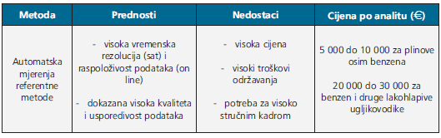
5.4 MAINTENANCE AND NETWORK COSTS
The cost of measuring equipment
Energy Research and Environmental Protection Institute

Slide 46
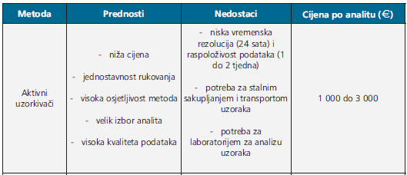
5.4 MAINTENANCE AND NETWORK COSTS
Extension table
Energy Research and Environmental Protection Institute

Slide 47
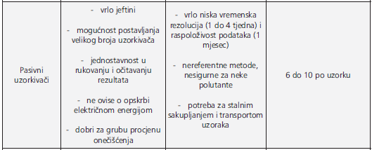
5.4 MAINTENANCE AND NETWORK COSTS
Extension table
Energy Research and Environmental Protection Institute

Slide 48
5.4 MAINTENANCE AND NETWORK COSTS
Sensors
Still in development:
very large measurement uncertainty
do not use the reference method
unreliable
cheap
they achieve a good spatial and temporal resolution
1000-2000 EUR per sensor
Energy Research and Environmental Protection Institute

Slide 49
5.4 MAINTENANCE AND NETWORK COSTS
By summing up the costs of setting up and maintaining the air quality monitoring network, we conclude that the use of reference methods for the needs of the network with the usual goals is still the most favorable (value for the funds invested). This would give start costs for the average station (measuring and non-measuring equipment and other costs) from 150 to 200 thousand euros per station.
Energy Research and Environmental Protection Institute

Slide 50
5.4 MAINTENANCE AND NETWORK COSTSORK
The annual cost of the network, with the involvement of quality testing laboratory (which can guarantee targeted data quality and traceability), a reliable and fast service team, including the costs of consumables and spare parts, should range from 20 to 25 thousand euros per station.
For such investments each investor expects and requires a satisfactory quality data that meet all regulatory requirements.
Energy Research and Environmental Protection Institute

Slide 51
THANK YOU FOR YOUR ATTENTION
Energy Research and Environmental Protection Institute
Disclaimer: The contents of this publication are the sole responsibility of EKONERG – Energy Research and Environmental Protection Institute, Ltd. and can in no way be taken to reflect the views of the European Union
This project is funded by the European Union

